Slide 1
Capstone project -1
CUSTOMER SATISFACTION ANALYSIS
Name : Suraj Negi
Course : Postgraduate Program in Machine Learning and Artificial Intelligence
Instructor : Mr. Ashutosh Hiskiel
Date : 6th April 2024

Slide 2
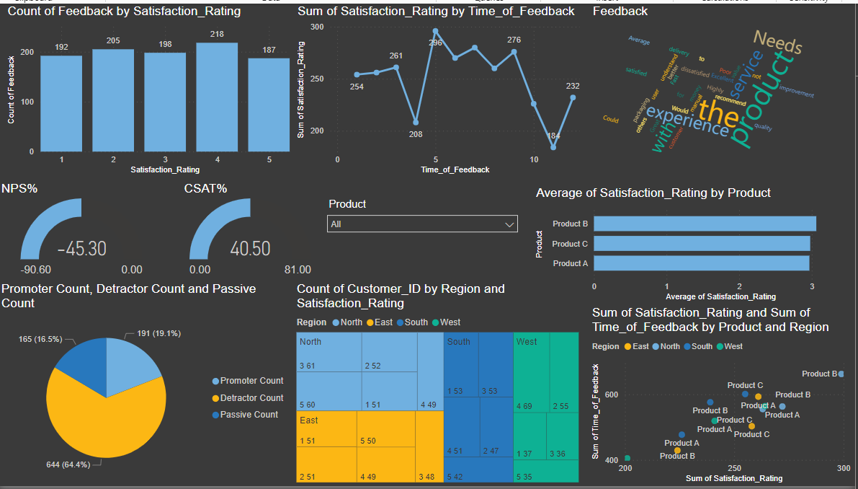
Dashboard on Customer Satisfaction Analysis:

Slide 3
Use of DAX Measure for Dashboard in Power BI:
Satisfied Customers = CALCULATE( COUNTROWS('customer_feedback_data'), 'customer_feedback_data'[Satisfaction_Rating] >= 4)
Total Responses = COUNTROWS('customer_feedback_data')
CSAT% = DIVIDE([Satisfied Customers], [Total Responses]) * 100
Detractor Count = CALCULATE(COUNTROWS('customer_feedback_data'), 'customer_feedback_data'[NPS] <= 6)
Passive Count = CALCULATE( COUNTROWS('customer_feedback_data'), 'customer_feedback_data'[NPS] >= 7 && 'customer_feedback_data'[NPS] <= 8)
Promoter Count = CALCULATE(COUNTROWS('customer_feedback_data'), 'customer_feedback_data'[NPS] >= 9)
Total Count = COUNTROWS('customer_feedback_data‘)
NPS% = DIVIDE([Promoter Count] - [Detractor Count], [Total Count]) * 100

Slide 4
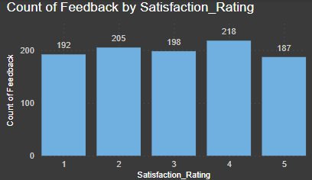
Satisfaction Rating Distribution:
Column Chart: Represent the count or percentage of feedback for each satisfaction rating.

Slide 5
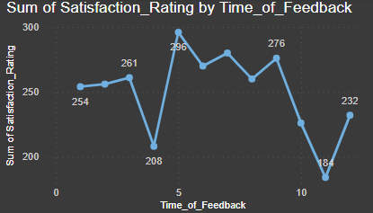
Trend Analysis:
Line Chart: Analyze the trend of satisfaction ratings over time.

Slide 6
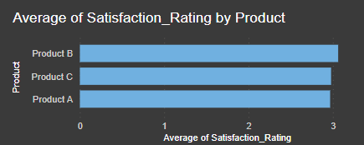
Comparison:
Bar Chart: Compare average satisfaction ratings across different products, regions, or demographic segments.

Slide 7
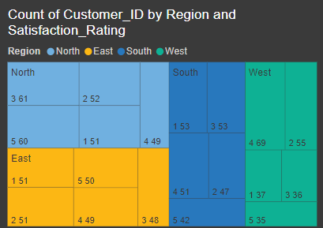
Segmentation Analysis:
Treemap: Segment customers based on satisfaction ratings and other variables like product or region.

Slide 8
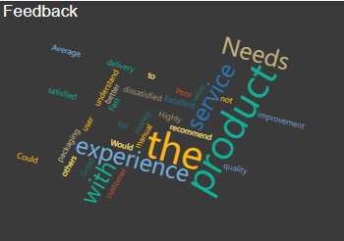
Customer Feedback Analysis:
Word Cloud: Highlight commonly occurring words or phrases in customer feedback.

Slide 9
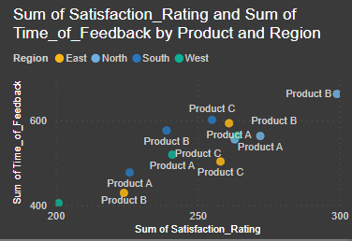
Correlation Analysis:
Scatter Plot Matrix: Explore correlations between satisfaction ratings and other variables simultaneously.

Slide 10
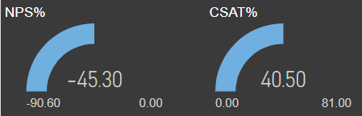
Gauges:
Gauges: Provide a visual representation of satisfaction metrics against predefined thresholds.

Slide 11

What is CSAT?
CSAT, or Customer Satisfaction Score, is a metric that measures customer satisfaction by asking customers to rate their experience on a scale.
It helps businesses gauge the effectiveness of their products or services.

Slide 12
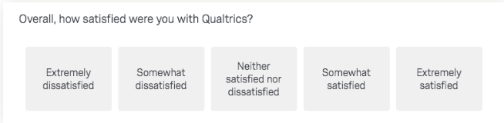
How Is CSAT Measured?
CSAT is measured by one or more variations of this question that usually appears at the end of a customer feedback survey:
“How would you rate your overall satisfaction with the [goods/service] you received?”
Respondents use the following 1 to 5 scale: 1. Very unsatisfied 2. Unsatisfied 3. Neutral 4. Satisfied 5. Very satisfied

Slide 13
Calculating CSAT:
To do this, only responses of 4 (satisfied) and 5 (very satisfied) are included in the calculation, as it has been shown that using the two highest values on feedback surveys is the most accurate predictor of customer retention.
(Number of satisfied customers (4 and 5) / Number of survey responses) x 100 = % of satisfied customers

Slide 14

What is NPS?
Net Promoter Score (NPS) is a measure used to gauge customer loyalty, satisfaction, and enthusiasm with a company that’s calculated by asking customers one question: “On a scale from 0 to 10, how likely are you to recommend this product/company to a friend or colleague?” Aggregate NPS scores help businesses improve upon service, customer support, delivery, etc. for increased customer loyalty.

Slide 15

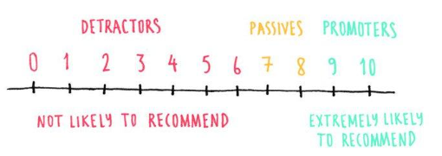
How to calculate NPS?
In the Net Promoter system, customers are categorized into three groups—promoters, detractors, passives—depending on how they answer the standard “how likely are you to recommend us” question:

Slide 16
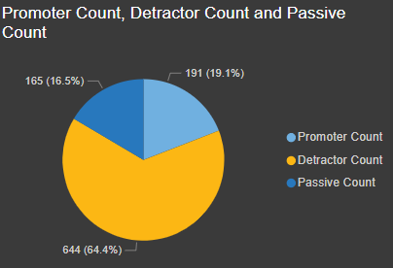
Promoter, Detractor and Passive Count:

Slide 17
Conclusion:
A Net Promoter Score of -45.30% indicates that there are significantly more detractors (customers who are not satisfied and may even actively discourage others from using the product or service) than promoters (customers who are satisfied and likely to recommend the product or service). This suggests that there may be issues or dissatisfaction among the customer base that need to be addressed in order to improve overall satisfaction and loyalty.
A CSA suggests that 40.50% of the surveyed customers are satisfied with the product or service being assessed. This score indicates a moderate level of satisfaction but leaves room for improvement.

Slide 18


